Slide 1
Robotics Teacher Training Workshop
George School
May 4-5, 2018

Slide 2
Login & WiFi Information
Wireless Network (SSID): mygswireless
GS Computer/WIFI Username: robotics
GS Computer/WiFI Password: GSRobotics2018
Wireless Network (SSID): GSAlumniWeekend
Wireless Password: WelcometoGS

Slide 3
File Locations
Download workshop files here:
www.pcrduino.com/workshops/

Slide 4
Introductions
Chris Odom
Brian Patton
Attendees

Slide 5
Friday’s Agenda (May 4, 6pm-9pm)
Survey Results and What is Physical Computing
Code Tutorial #1: The Basics
Embedded Controller Comparisons and Pros & Cons
Code Tutorial #2: I/O Devices
Robotics Platform Comparisons and Pros & Cons
Code Tutorial #3: Autonomous Robot
Tour of the Facilities
Computer Science at George School
Round Table Discussions: Building a Program/Involving Students
Saturday Reminders (SAT bathroom breaks, Parking, Lunch)

Slide 6
Participant Preference Survey Results
Here’s the comfort level (1-10) of the group:
Programming: 4.8 ± 2.6
Electronics: 4.9 ± 2.3
Design and CAD: 5.3 ± 2.1
Building Robots and Other Mechanicals: 5.8 ± 2.0

Slide 7
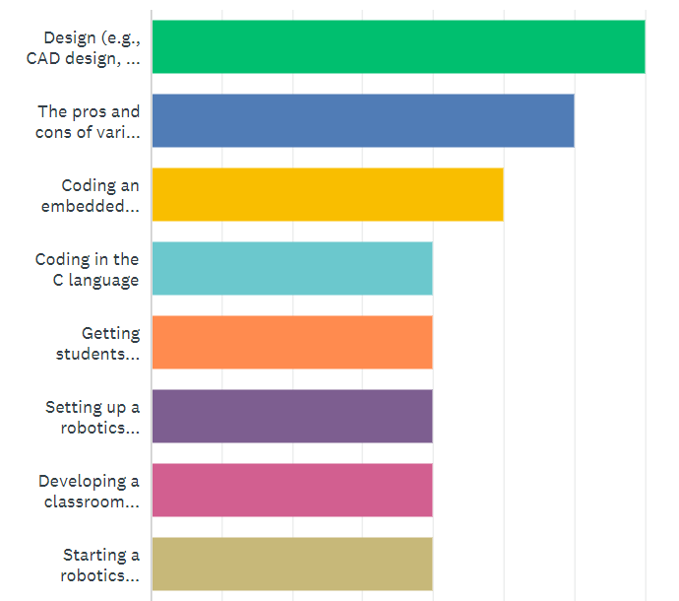
Participant Preference Survey Results
Here’s what you said you want to talk about:
  https://www.surveymonkey.com/analyze/3_2BO2af4D8Y5i8t_2F0YcgwYGtRm_2FRkFde_2Fyl1n8wSpo1M_3D

Slide 8
Keep this in mind…
There is no way to cover everything (or hardly anything) today.
We want to start a dialog and meet like-minded people who share our excitement.
We want to be a resource and establish a resource network.
What we will show you today is NOT the way to teach physical computing and robotics to your students.
We simply want to share the power and possibilities of physical computing and embedded controller systems.

Slide 9
Physical Computing: Desktop Computing on Steroids
Use the same code as desktop applications, but use it to control physical devices.
Physical computing is about controlling devices other than a computer. Things like: LEDs, buzzers, servomotors, DC motors, relays, and other actuators.

Slide 10
Physical Computing: Sensors
Physical computing is also about gathering information from sensors and other input devices such as keyboards, buttons, and switches. What we can sense today is incredible: temperature, light, force, flexion, range (distance), rotation, acceleration, magnetic field, voltage, current, moisture, fire, CO, pH, turbidity, conductivity, GPS, infrared, UV, muscle contraction, vision, … the list goes on and on and on.
Sensors are typically inexpensive and often come ready to plug in. However, it is fun to build your own, too!

Slide 11
Code Tutorial #1 Overview: The Basics
Hello World
  The obligatory first program!
  Often the hardest to write. Be patient, please…
Math and Variables
  The new ARM architecture has wicked-fast math processors. Let’s see a little of that now.
Using Modules
  Sort-of like a library, but easier.
  A great way to make your big applications more mod
Computer Logic
  The powerful if-then command!

Slide 12
Coding Process for the Embedded Controller
Code is written on the desktop/laptop computer using an IDE, such as Arduino. To appeal to the artist in each of us, Arduino calls computer programs “sketches”.
The language can vary, but is often C-based. (Arduino C, e.g.)
The code is compiled by the computer (via the IDE). Because the computer does the compiling, the robot brain can be small, fast, and inexpensive.

Slide 13
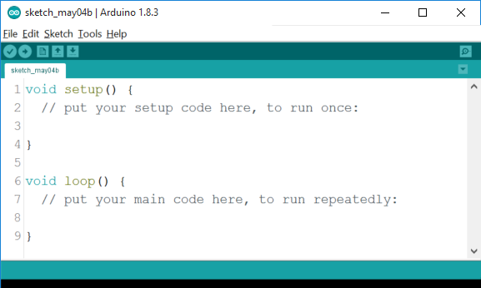
Set up The Arduino IDE and Robot
You wanted a coding tutorial, so let’s jump right in! (See Chapters 1& 2 in Vol 1 of the textbook.)
Connect your OneBot to your laptop via the USB Programming Cable. Allow the handshake to happen.
Open Arduino IDE
File >> Preferences
  Change font size to preferred size
  Check “Display line numbers”
Locate the code window, and make it big.

Slide 14
Set up The Arduino IDE and Robot
Verify that the computer recognizes the Teensy 3.2 Microcontroller:
Tools >> Board >> Teensy 3.2/3.1
Tools >> Port >> COM x (Teensy)
Tools >> USB Type >> Serial
If you do not see these settings, let us know now!

Slide 15
Code Tutorial #1: Hello World
void setup() {
// put your setup code here, to run once:
}
void loop() {
// put your main code here, to run repeatedly:
}

Slide 16
Save the file
File >> Save
Save the file as “hello”
Save it to the Robotics Workshop folder on the desktop.
It will automatically add the file to a folder.
Look for the “hello.ino” file in the desktop folder.

Slide 17
The Setup() and Loop() functions
Every Arduino sketch must have a setup() and loop() function.
For those familiar to programming, this is somewhat annoying, but we can get around it.
All code must go into some function.
For now, we’ll write all our code inside setup() and loop().
Notice that each function begins with the void keyword, and is bracketed at the beginning and end with curly braces: { }.

Slide 18
Code Tutorial #1: Hello World
void setup() {
// put your setup code here, to run once:
Serial.begin(9600);
}
void loop() {
// put your main code here, to run repeatedly:
Serial.print("Hello");
delay(500);
}
Notes:
Every Arduino sketch must have a setup() and loop() function.
For those familiar to programming, this is somewhat annoying, but we can get around it.
All code must go into some function.
For now, we’ll write all our code inside setup() and loop().
Notice that each function begins with the void keyword, and is bracketed at the beginning and end with curly braces: { }.

Slide 19
Code Tutorial #1: Hello World
// hello.ino
// by c.d.odom on 5.4.18
void setup() {
// put your setup code here, to run once:
Serial.begin(9600); // set baud rate for Serial Monitor
}
void loop() {
// put your main code here, to run repeatedly:
Serial.print("Hello"); // print message to screen
delay(500); // pause for 500ms (0.5s)
}
Notes:
Comments are for the human reader’s benefit only.
Commenting is an excellent habit to form, but to save time, you may want to skip them here if you get behind.

Slide 20

Verify
Verify the code now, via Sketch >> Verify/Compile
  This will check for code errors
  No microcontroller needed for this step

Slide 21
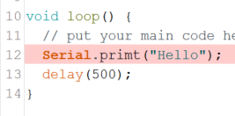

Got Errors?
If there are errors, fix them now. We have folks to help!

Slide 22

Verify and Upload
If no errors, then upload the code the Teensy microcontroller via Sketch >> Upload
WAIT! Be Patient!

Slide 23
Coding Process for the Embedded Controller
The compiled (machine) code is downloaded to the microcontroller, usually via a USB programming cable.
Once the code is on the microcontroller, it can be executed repeatedly – no computer is necessary.
The code remains in the EEPROM (memory) of the microcontroller forever.
New code can be written and uploaded to the robot brain practically as many times as desired. Old code is overwritten.
Notes:
Code is written on the desktop/laptop computer using an IDE, such as Arduino. To appeal to the artist in each of us, Arduino calls computer programs “sketches”.
The language can vary, but is often C-based. (Arduino C, e.g.)
The code is compiled by the computer (via the IDE). Because the computer does the compiling, the robot brain can be small, fast, and inexpensive.
The compiled (machine) code is downloaded to the microcontroller, usually via a USB programming cable.
Once the code is on the microcontroller, it can be executed repeatedly – no computer is necessary.
The code remains in the EEPROM (memory) of the microcontroller forever.
New code can be written and uploaded to the robot brain practically as many times as desired. Old code is overwritten.

Slide 24
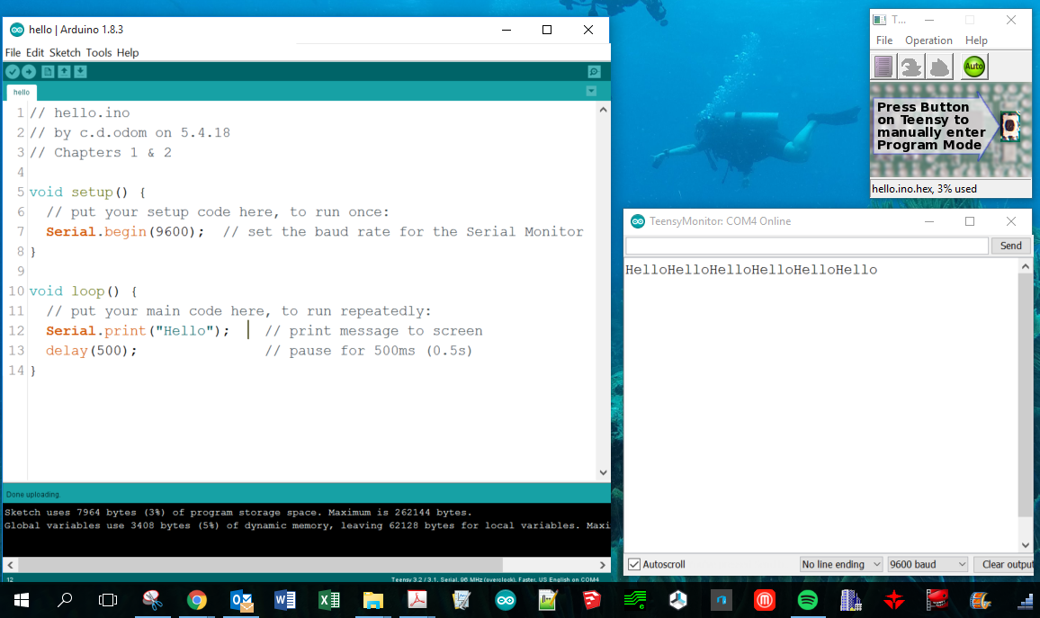
View the Output
To view the program’s output, open the Serial Monitor via Tools >> Serial Monitor
Arrange windows so you can code window, the Serial Monitor, and Teensyduino window:

Slide 25
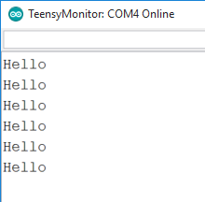
Code Tutorial #1: Hello World
Make one tiny change to your code and re-upload:
Serial.println("Hello"); // print message to screen
Notes:
Code is written on the desktop/laptop computer using an IDE, such as Arduino. To appeal to the artist in each of us, Arduino calls computer programs “sketches”.
The language can vary, but is often C-based. (Arduino C, e.g.)
The code is compiled by the computer (via the IDE). Because the computer does the compiling, the robot brain can be small, fast, and inexpensive.
The compiled (machine) code is downloaded to the microcontroller, usually via a USB programming cable.
Once the code is on the microcontroller, it can be executed repeatedly – no computer is necessary.
The code remains in the EEPROM (memory) of the microcontroller forever.
New code can be written and uploaded to the robot brain practically as many times as desired. Old code is overwritten.

Slide 26
Code Tutorial #1: Delay
Make another tiny change to your code and re-upload:
delay(50); // pause for 50ms (0.05s)
The data should scroll 10x faster!
Notes:
Code is written on the desktop/laptop computer using an IDE, such as Arduino. To appeal to the artist in each of us, Arduino calls computer programs “sketches”.
The language can vary, but is often C-based. (Arduino C, e.g.)
The code is compiled by the computer (via the IDE). Because the computer does the compiling, the robot brain can be small, fast, and inexpensive.
The compiled (machine) code is downloaded to the microcontroller, usually via a USB programming cable.
Once the code is on the microcontroller, it can be executed repeatedly – no computer is necessary.
The code remains in the EEPROM (memory) of the microcontroller forever.
New code can be written and uploaded to the robot brain practically as many times as desired. Old code is overwritten.

Slide 27
Code Tutorial #1: Infinite Pause
// hello.ino
// by c.d.odom on 5.4.18
void setup() {
// put your setup code here, to run once:
Serial.begin(9600); // set baud rate for Serial Monitor
}
void loop() {
// put your main code here, to run repeatedly:
Serial.print("Hello"); // print message to screen
delay(50); // pause for 50ms (0.05s)
while(true); // pause indefinitely
}
Notes:
Code is written on the desktop/laptop computer using an IDE, such as Arduino. To appeal to the artist in each of us, Arduino calls computer programs “sketches”.
The language can vary, but is often C-based. (Arduino C, e.g.)
The code is compiled by the computer (via the IDE). Because the computer does the compiling, the robot brain can be small, fast, and inexpensive.
The compiled (machine) code is downloaded to the microcontroller, usually via a USB programming cable.
Once the code is on the microcontroller, it can be executed repeatedly – no computer is necessary.
The code remains in the EEPROM (memory) of the microcontroller forever.
New code can be written and uploaded to the robot brain practically as many times as desired. Old code is overwritten.

Slide 28
Code Tutorial #1: While Loops
The while statement is a looping command. That line will loop while the argument in parentheses () is true. Because true is always true, the loop never ends.
while(true); // pause indefinitely
Run it again and you’ll see the Hello message only once. You can also write the while loop in a block format using curly braces:
while(true){
// pause indefinitely
}
Notes:
Code is written on the desktop/laptop computer using an IDE, such as Arduino. To appeal to the artist in each of us, Arduino calls computer programs “sketches”.
The language can vary, but is often C-based. (Arduino C, e.g.)
The code is compiled by the computer (via the IDE). Because the computer does the compiling, the robot brain can be small, fast, and inexpensive.
The compiled (machine) code is downloaded to the microcontroller, usually via a USB programming cable.
Once the code is on the microcontroller, it can be executed repeatedly – no computer is necessary.
The code remains in the EEPROM (memory) of the microcontroller forever.
New code can be written and uploaded to the robot brain practically as many times as desired. Old code is overwritten.

Slide 29
Code Tutorial #1: Wait for Serial Monitor
If you want to wait to ensure the Serial Monitor is opened before the loop() function is executed, you can alter the setup() function like so:
void setup() {
// put your setup code here, to run once:
Serial.begin(9600); // set baud rate for Serial Monitor
while(!Serial); // loop while Serial Monitot is NOT open
}
The exclaimation point (!) is the NOT operator and is called “bang”. The program will loop here while the Serial Monitor is NOT open.
Notes:
Code is written on the desktop/laptop computer using an IDE, such as Arduino. To appeal to the artist in each of us, Arduino calls computer programs “sketches”.
The language can vary, but is often C-based. (Arduino C, e.g.)
The code is compiled by the computer (via the IDE). Because the computer does the compiling, the robot brain can be small, fast, and inexpensive.
The compiled (machine) code is downloaded to the microcontroller, usually via a USB programming cable.
Once the code is on the microcontroller, it can be executed repeatedly – no computer is necessary.
The code remains in the EEPROM (memory) of the microcontroller forever.
New code can be written and uploaded to the robot brain practically as many times as desired. Old code is overwritten.

Slide 30
Microcontroller Handling Warnings!
These microcontrollers are quite robust, but they are not toys and can be damaged if care is not taken.
When the programming cable is plugged in, the microcontroller has power. Be careful that you don’t set it down on metal. Even an itty-bitty staple can short it!
  Plug into a breadboard, use standoffs, or attach it to a robot.
Be careful of the micro USB connector! It pries off easily.
Don’t bathe with it.

Slide 31
Microcontroller Upload Warnings!
While the computer is downloading code to the microcontroller …
  NEVER unplug the microcontroller!
  NEVER upload more code!
  Be patient! Wait for the software to tell you the code has been uploaded.
  It seems that some of these issues have been resolved recently for Teensy 3.2 users, as the new boards are now made in the USA. These seem to be more robust and less susceptible to the above issues.

Slide 32
Upload Hints
  Some ways to prevent microcontroller damage:
    Verify code before uploading.
    Start each program with a function that flashes the onboard LED. Then, when you see the blinking LED, you know the code is running and it is ok to unplug.
    Listen to the plinky sounds of the IDE confirming that the code has downloaded.
    Read the messages on the IDE that confirm the code has been downloaded.

Slide 33
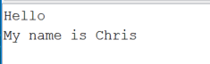
Code Tutorial #1: Variables and Concatenation
void loop() {
// put your main code here, to run repeatedly:
Serial.print("Hello"); // print message to screen
String myName = "Chris"; // make a String variable
Serial.println ("My name is " + myName); // concatenate!
delay(50); // pause for 50ms (0.05s)
while(true); // pause indefinitely
}

Slide 34
Code Tutorial #1: A Math Function
Create a new function below the loop() function:
void print2x3(){
// create floating-point variables
float x = 2.0;
float y = 3.0;
float product; // establish a new variable
product = x * y; // assign it a value
Serial.println ("2 x 3 = " + String(product));
}

Slide 35
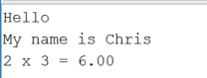
Code Tutorial #1: Call the function
We must “call” the function from within the loop() to run the code:
void loop() {
Serial.println("Hello");
String myName = "Chris";
Serial.println ("My name is " + myName
print2x3(); // call this function
delay(50);
while(true);
}

Slide 36
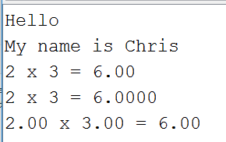
Code Tutorial #1: More ways to print
void print2x3(){
...
Serial.println ("2 x 3 = " + String(product));
Serial.println ("2 x 3 = " + String(product, 4));
Serial.println (String(x) + " x " + String(y) + " = " +
String(product));
}

Slide 37
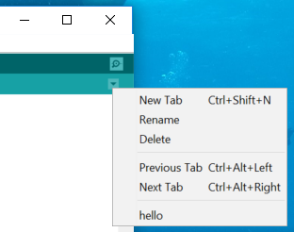

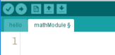
Code Tutorial #1: Create a Module
Create a new module by adding a New Tab:

Slide 38
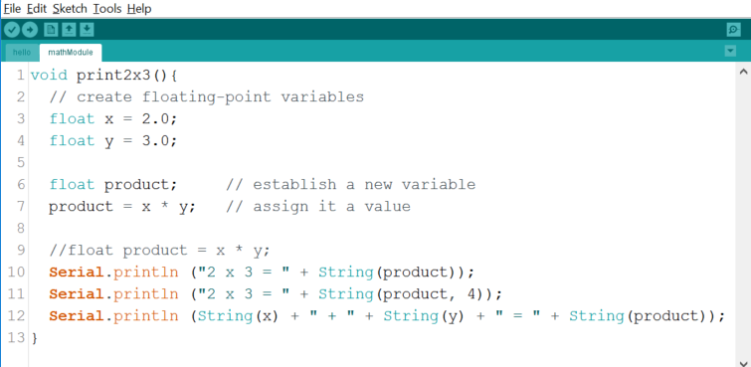
Code Tutorial #1: Move code to the Module
Cut the product2x3() void function from the main module and paste it into the mathModule. Then run it. Modules help organize your code.

Slide 39
Code Tutorial #1: Saving Time
In the interest of time, visit my book’s website and copy the next algorithm and paste it into the mathModule. Here’s how:
Point your browser to www.pcrduino.com and select Workshops from the menu bar.
Click on the link entitled, “printProduct”.
Copy all of the code.
Return to Arduino and paste the code at the bottom of the mathModule module.
Your code should look like this…

Slide 40
Code Tutorial #1: The Updated math Module
void print2x3() {
// a void function
// create floating-point variables
float x = 2.0;
float y = 3.0;
float product; // establish a new variable
product = x * y; // assign it a value
//float product = x * y;
Serial.println ("2 x 3 = " + String(product));
Serial.println ("2 x 3 = " + String(product, 4));
Serial.println (String(x) + " x " + String(y) + " = " + String(product));
}
void printProduct(float x, float y) {
// a void function with arguments
// multiply the "passed arguments, x and y"
float product = x * y;
Serial.println (String(x) + " x " + String(y) + " = " + String(product));
}

Slide 41
Code Tutorial #1: A Void with Arguments
void printProduct(float x, float y) {
// a void function with arguments
// multiply the "passed arguments, x and y"
float product = x * y;
Serial.println (String(x) + " x " + String(y) + " = " + String(product));
}

Slide 42
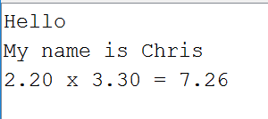
Code Tutorial #1: Call the New Function
void loop() {
// put your main code here, to run repeatedly:
Serial.println("Hello");
String myName = "Chris";
Serial.println ("My name is " + myName
// print2x3(); // call this function
printProduct(2.2, 3.3); // send arguments x & y
delay(50);
while(true);
}

Slide 43
Code Tutorial #1: A Non-Void Function
Again, point your browser to www.pcrduino.com/workshops and select copy all of the code from the calcProduct link. Paste it at the bottom of the mathModule module:
float calcProduct(float x, float y) {
// a non-void function with arguments
// multiply the "passed arguments, x and y" as usual:
float product = x * y;
// but now return product to the variable that called it:
return product;
}

Slide 44
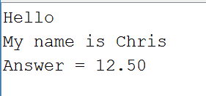
Code Tutorial #1: Call the New Function
void loop() {
// put your main code here, to run repeatedly:
Serial.println("Hello");
String myName = "Chris";
Serial.println ("My name is " + myName);
// print2x3();
// printProduct(2.2, 3.3);
float value = calcProduct(0.5, 25);
Serial.println ("Answer = " + String(value));
delay(50);
while(true);
}

Slide 45
Code Tutorial #1: Logic
void loop() {
...
float value = calcProduct(0.5, 25);
Serial.println ("Answer = " + String(value));
[copy “ifValue” code and paste it here]
delay(50);
while(true);
}
Notes:
Play. Try
10, 10
9.99, 9.99
12, 12 → why doesn’t this work!?
2, 3
-1, 2000 → add code to check for negative

Slide 46
Microcontrollers: PIC, AVR, & ARM
Feature | PIC | AVR | ARM
Common Products | Basic Stamp (BS1, BS2px) | Teensy 2.0 Arduino Uno | Teensy 3.2 Arduino Due
Release Date | 1993 (very old) | 2010 (old) | 2012 (new)
I/O Voltage | 5.0 V | 5.0 V | 3.3 V (Teensy is 5-volt tolerant)
Speed | 4 MHz | 16 MHz | 72-96 MHz
Resolution | 8-bit | 8-bit (typical) | 16-bit (13-bit practical limit)
Future Use | Unlikely. | Maybe? | Absolutely!
Flash Memory | 256 Bytes – 16 Kb | 32 Kb | 256 Kb (Teensy 3.2) 512 Kb (Due)
I/O pins (Digital/Analog) | 8-16 | Teensy 2.0: (24/10) Uno: (14/6) | Teensy 3.2: (24/10) Due: (54/12)
Cost | $40 - $79 | $20 | $19 (Teensy 3.2) $45 (Due)

Slide 47
ARM Wins!
For multiple reasons, we prefer the ARM architecture:
Processing speed
Unbelievable math engine
More efficient (3.3V)
Higher resolution (13-bit practical)
But most importantly: every physical computing device is moving in that direction. It will still be viable in ten years!
{ARM stands for Advanced RISC Machines.
RISC stands for Reduced Instruction Set Computer.}

Slide 48
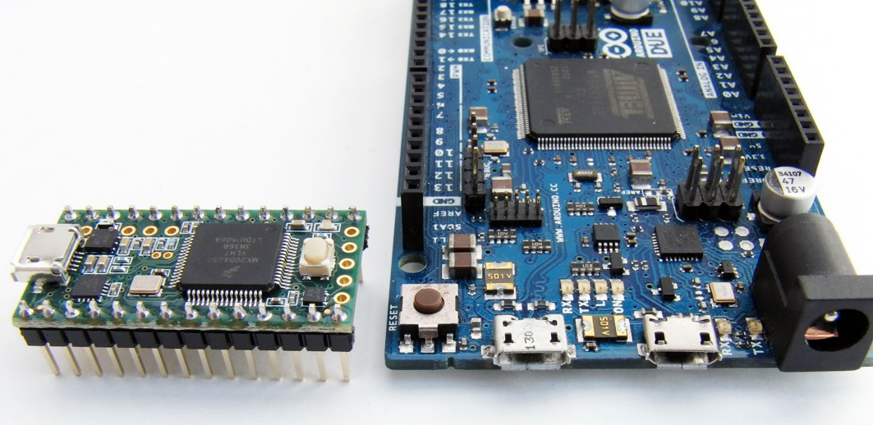
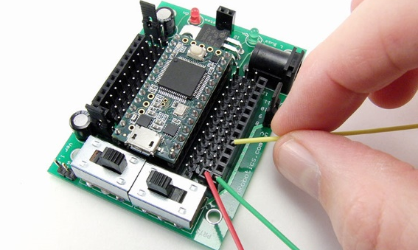
But Which ARM?
For multiple reasons, we prefer the Teensy 3.2/3.5 controller:
Smaller footprint
Much less expensive
Works great with the
PRT3 Motherboard…
Full disclosure: Brian’s company, Patton Robotics, is the maker of the PRT3 Motherboard

Slide 49
Motherboards: PRT3/Teensy vs Arduino Due
Feature | PRT3 & Teensy 3.2 | Arduino Due
ARM Architecture? | ✓ | ✓
Replaceable Microcontroller? | ✓ | ✗
5-volt tolerant I/O pins? | ✓ | ✗
No Shields Required? | ✓ | ✗
Main Power Switch? | ✓ | ✗
Auxiliary Power Switch? | ✓ | ✗
Full Male and Female Headers? | ✓ | ✗
Plug-n-Play Capable? | ✓ | ✗
Direct Bluetooth/RF Comm Plug-In? | ✓ | ✗
Breadboard-able Microcontroller? | ✓ | ✗
DIY Kit Option? | ✓ | ✗
Available Power & Ground pins | 27/26 | 3/3
I/O Pins (Digital/Analog/PWM) | 24/10/10 * | 54/12/12
Footprint | 50 x 68 mm | 53 x 104
Retail Cost | $38-$45 (together) | ~$45 (currently sold out)
Made in the USA | ✓ | ✗
* For a TON of I/O pins and an SD card reader, consider the Teensy 3.5 and Patton Robotics Motherboard.

Slide 50
Code Tutorial #2 Overview: I/O Devices
Download code from www.pcrduino.com/workshops/
RGB LED Outputs
Loops
Analog Sensors and the Voltage Divider Board
  sensorBigDemo demonstration
Sensor setup (analog pins)
  Light (photoresistor), Force (commercial & homemade), Flex, Temperature, etc.
Output visualizations
  Serial Monitor
  Serial Plotter (with and without axis scale)
Computer Logic Decision Tree
Temperature – The Full Treatment

Slide 51
Code Tutorial #2: RGB with LED Module
Save a new file as “RGB.ino” in desktop folder
Download “LEDModule.ino” from www.pcrduino.com/workshops/ and put it in the RGB folder that is inside the desktop folder.
Add the LED module: Sketch >> Add file >> find “LEDModule.ino”
Copy/paste the global variables and the setup() function at the top of “LEDModule” and put them at the very top of the RGB sketch.
Examine the LED Module:
  blinkOK()
  blinkNum()
  blinkLEDNum()
  digitalRGB()
  fadeInLED(), fadeOutLED()
  displayRGB()
Notes:
Play!

Slide 52
Code Tutorial #2: Sensor Module
Save a new file as “sensors.ino” in desktop folder
Download “sensorModule.ino” from www.pcrduino.com/workshops/ and put it in the sensors folder that is inside the desktop folder.
Add the sensor module: Sketch >> Add file >> find “sensorModule.ino”
Copy/paste the global variables and the setup() function at the top of “LEDModule” and put them at the very top of the RGB sketch.
Examine the LED Module:
  blinkOK()
  blinkNum()
  blinkLEDNum()
  digitalRGB()
  fadeInLED(), fadeOutLED()
  displayRGB()
Notes:
Play!

Slide 53
Code Tutorial #2: Temperature
See pages xxx in xxx
Temperature Sensor (Thermistor & VDB) Measurement
  Sensor setup
  Serial Monitor output
  Serial Plotter output
A-to-D Conversions
Voltage Divider Boards
Temperature Conversion
Computer Logic and the RGB

Slide 54
Robot Platforms: OneBot, LEGO, VEX, First, Boe-Bot
Needed expandable platform with infinite growth potential. (cf. LEGO, VEX, Boe-Bot)
Requires no proprietary (i.e. expensive) components. (cf. LEGO and VEX)
Requires real coding. A marketable skill. No drag and drop. (cf. LEGO and VEX (with Blocky))
Affordable. Allows for one student per robot. Students don’t have to fight for a chance to work on one big robot. (cf. FIRST and VEX)
DIY Kit. Fosters creation, not simply building. (cf. Boe-Bot)
Designed for autonomous robotics – not remote control. (cf. FIRST and LEGO)
Superior construction (durable air craft aluminum, lots of mounting options). (cf. Boe-Bot and LEGO)
Patton Robotics is focused on education. (+ Brian is a genius and all-around great guy.)

Slide 55
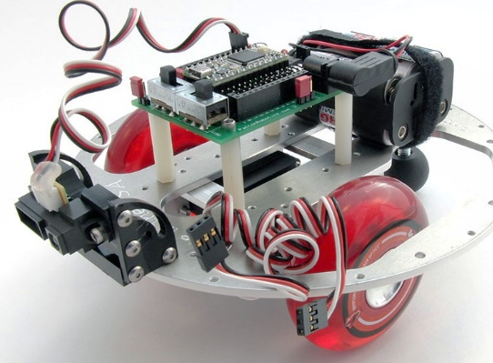
My Choice: The Patton Robotics OneBot
Obviously, I settled on the OneBot educational platform from Patton Robotics.
Here are some reasons why:

Slide 56
Code Tutorial #3: Autonomous Robot

Slide 57
Tour of the Facilities
FISHBOWL
  Fabrication and Integration of Software and Hardware for Bot Operations Workshop Laboratory
Classroom
3D Printers
Laser Cutter
Robotic Arm
  Basement is off limits during SAT
Science classrooms?

Slide 58
Early Robotics at George School (2002-2010)
Desktop business application programming. Boring. 6 students.
Only one technology course – needed to cover all bases.
Robotics was the solution (mix of coding, electronics, mechanics). But which platform? LEGO, FIRST? NASA + Brian = BX-24.
Started with six loaner BX-24 bots from Brian. We’d destroy them, he’d redesign them.
Students shared robots (2 per bot). Classes shared robots (1 set per 2 classes).
Within three years: 2 classes and 32 students + waiting list.
Primitive facilities, limited equipment, basic assignments, but great fun! (We didn’t know any better.) Students started pushing the envelope.

Slide 59
GS Robotics – The Middle Years (2006-2012)
Physically and mentally demanding to teach the curriculum. The pace problem.
So I wrote a textbook around the BX-24 microcontroller so I wouldn’t have to talk so much and wouldn’t forget what I knew.
Started developing more a comprehensive curriculum and more sophisticated projects. Let students propel and scaffold the program!
Students read the book and paced themselves. Solved the pace problem.
6 months after publishing 5000 textbooks, BX-24 ceased production and print-on-demand publishing became affordable. Horrific timing!

Slide 60
GS Robotics Today
Readers of my BX-24 book asked for a new book around a new embedded controller.
Arduino was growing in popularity, but some serious issues for educators.
Again, enter Brian Patton, the Teensy, and the OneBot.
Like child birth, I forgot how painful it was to write a book.
Two new textbooks later, GS now has three full robotics classes, AP Computer Science A classes, and Advanced Independent Study courses. All told, about 70 students per year.

Slide 61
GS Robotics Today
Year-long course. Three sections.
Each student has their own OneBot and toolbox.
Lab skills:
  Soldering – practice boards, small circuits, PRT3 Motherboard
  CAD, 3D Printing, and Laser Cutting
  Machine tools
Students purchase their own Teensy, PRT3, and batteries. For an additional $12 they can leave with a 3D-printed or laser-cut robot.
Terms 1 & 2 = Volumes 1 & 2. Term 3 = Independent Projects.
Competitions and an Open House

Slide 62
The Future of GS Computer Science
New integrated curriculum
New projects laboratory
Continue to foster minority and female involvement
Addition of AP Computer Science Principles?
Break into the 9th grade curriculum?

Slide 63
Textbooks and Other Resources
Only one textbook.
Lots of online resources, but…
  They are great for those who have some knowledge and skills.
  They don’t start at the beginning.
  Requires some expertise, resourcefulness, and patience.
  “Lessons” are not sequential.
  Poor pedagogical methodology. (Not meant to educate.) They give you the fish.
  No curriculum.

Slide 64
Round Table Discussion
Getting students interested
Starting a course
Starting an after school program or club
Setting up a robotics lab
A STEAM curriculum
AP CS Principles
Textbooks
Competitions
Embedded Controllers in Science Classes
STEAM and other collaborations
Coding, designing, and working with/for the community. People will find you!
Issues and Opportunitiesat your schools?

Slide 65
Take-Away’s
Real coding
Real electronics
Real engineering
Real learning.
Education, not robotics.

Slide 66
Download your work
Use your Flash Drive to save any code or other files that you may want to take with you.

Slide 67
Saturday’s Agenda (May 5, 9AM-3PM)
Help up set tomorrow’s agenda:
Robotics
Environmental Sensing
CAD for 3D Printing
CAD for Laser Cutting
3D Printing
Laser Cutting
Student Projects

Slide 68
Social Media
YouTube
  Tutorials
  Final Projects

Slide 69
3D Printing
We prefer the DIY kits
  Great experience for students to assemble
  Easy to replace/repair
Inexpensive (especially DIY kits)
Requires careful attention and routine alignment
Have spare parts on hand
Limit filament colors
Requires CAD (SketchUp, Tinkercad, Solidworks, AutoCAD, etc…)
Requires 3D Printer Host Program (Repetier, MakerWare, etc…)

Slide 70
Laser Cutting
Very happy with our Boss LS-1630
  Can not cut metal. (Our Arts department has the LS-2436, which does cut steel sheets.)
Expensive (LS-1630: ~$10K. HS-2436: ~$15K)
Requires some routine maintenance
Proper setup is critical – don’t go it alone
Super easy to use; flawless; cutting edge technology (ha, ha)
Suggest 2D drawing CAD (eMachineShop, e.g.)
Requires Laser Host Program (RDWorks, e.g.)

Slide 71
Two more Surveys
Workshop Evaluation: xxx
Permission to Share Emails: https://www.surveymonkey.com/r/9Z6FNSG

